Slide 1

Introduction to Digital Speech Processing

Slide 2
Contents
The Speech Signal
The Speech Stack
Applications of Digital Speech Processing (DSP)

Slide 3
Speech Signal

Slide 4
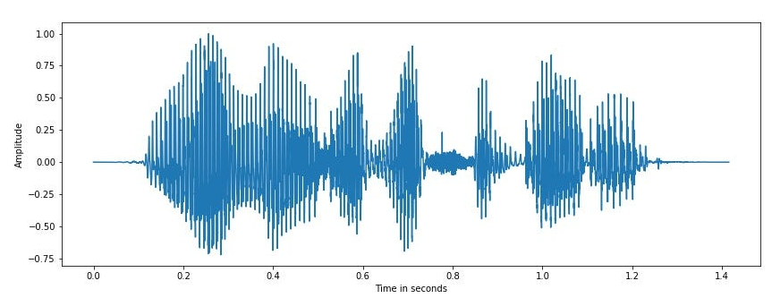
The Speech Signal
What is Speech Signal?
A speech signal is a time-varying waveform produced by human vocal organs during speech production.
Speech signals exhibit complex frequency, intensity, and duration patterns, conveying linguistic information.
Phonemes, syllables, and prosodic features comprise speech signals' basic components.

Slide 5
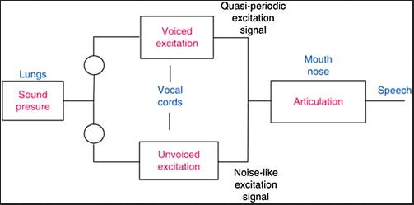
The Speech Signal
Production of Speech
Speech is produced by the movement of articulators (tongue, lips, vocal cords) in coordination with airflow from the lungs.
Speech Articulators: Discuss the role of the tongue, palate, teeth, and lips in shaping speech sounds.
Explain how different speech sounds (consonants, vowels) are formed based on articulatory positions.

Slide 6
The Speech Signal
Acoustic Properties of Speech
How is Speech Transmitted Acoustically?
Speech is transmitted as pressure waves in the air, carrying information about sound frequency and amplitude.
Spectral Characteristics of Speech Sounds
Frequency spectrum analysis reveals distinct patterns for different speech sounds (formants and harmonics).

Slide 7
The Speech Signal
Analog vs. Digital Speech
Continuous
waveform
representing
natural speech
Discrete-time
representation obtained
through sampling
and quantization
Advantages of Digital Speech Processing: Robustness, ease of storage, and manipulation compared to analog signals

Slide 8
The Speech Signal
Sampling and Quantization
Sampling Process in Speech Processing: Explain the Nyquist theorem and sampling rate selection for speech signals.
Quantization of Speech Signals: Discuss A/D conversion and bit depth for digitizing speech signals.
Digital Representation of Speech: Illustrate the concept of digital waveform using sampled speech examples.

Slide 9
The Speech Signal
Feature Extraction
Importance of Feature Extraction in Speech Processing: Extract meaningful speech recognition and analysis features.
Common Features:
Short-Time Energy: Measure signal energy in short-time frames.
Zero Crossing Rate: Estimate pitch and voicing characteristics.
Mel Frequency Cepstral Coefficients (MFCCs): Capture spectral characteristics for pattern recognition.

Slide 10
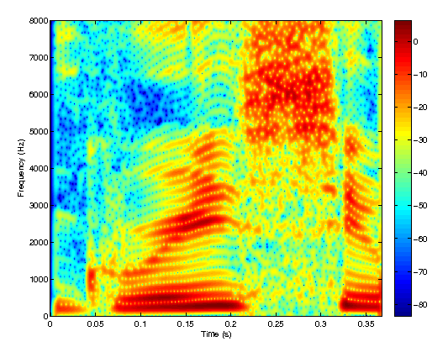
The Speech Signal
Time-Frequency Analysis
Fourier Transform and its Role:
Explain how the Fourier Transform decomposes speech signals into frequency components.
Short-Time Fourier Transform (STFT):
Analyze speech signals in short-time segments to capture time-varying frequency information.
Spectrogram Representation of Speech:
Illustrate spectrogram as a 2D visualization of the time-frequency content of speech signals.

Slide 11
The Speech Signal
Challenges in Digital Speech Processing
Noise and Distortion
Impacts speech quality and intelligibility.
Variability in Speech
Differences in accents, speaking rate, and style.
Speaker and Language Variations
Adaptation to different speakers and languages.

Slide 12
Speech Stack

Slide 13
The Speech Stack
Components of the Speech Stack
The speech stack represents the layers of processing involved in handling speech signals from acquisition to interpretation.
Speech signal acquisition, preprocessing, feature extraction, speech recognition, language understanding, speech synthesis, and post-processing.

Slide 14
The Speech Stack
Speech Signal Acquisition
Role of Speech Signal Acquisition in the Speech Stack: The first step involves capturing speech signals using microphones or sensors.
Microphones and Sensor Technologies: Types of microphones (e.g., condenser, dynamic) and their suitability for different applications.
Preprocessing Steps: Noise reduction techniques, signal amplification, and filtering to enhance signal quality.

Slide 15
The Speech Stack
Language Understanding
Natural Language Processing (NLP) in the Speech Stack
Syntax and Semantics Processing: Parsing speech into meaningful language constructs.
Contextual Understanding and Dialog Management: Interpreting user intents and maintaining conversation context.

Slide 16
The Speech Stack
Speech Signal Acquisition
Role of Speech Signal Acquisition in the Speech Stack: The first step involves capturing speech signals using microphones or sensors.
Microphones and Sensor Technologies: Types of microphones (e.g., condenser, dynamic) and their suitability for different applications.
Preprocessing Steps: Noise reduction techniques, signal amplification, and filtering to enhance signal quality.

Slide 17
The Speech Stack
Speech Synthesis
Basics of Speech Synthesis:
Techniques for generating speech from text or phonetic input.
Text-to-Speech (TTS) Techniques:
Concatenative Synthesis: Joining pre-recorded speech segments.
Parametric Synthesis (e.g., formant-based): Generating speech from vocal tract modeling.

Slide 18
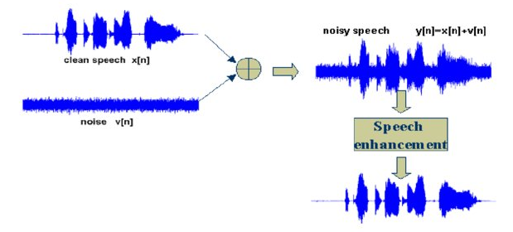
The Speech Stack
Speech Enhancement
Beamforming:
Focusing on the desired speech signal while suppressing noise.
Echo Cancellation:
Removing echo artifacts in speech signals.

Slide 19
Applications of DSP

Slide 20
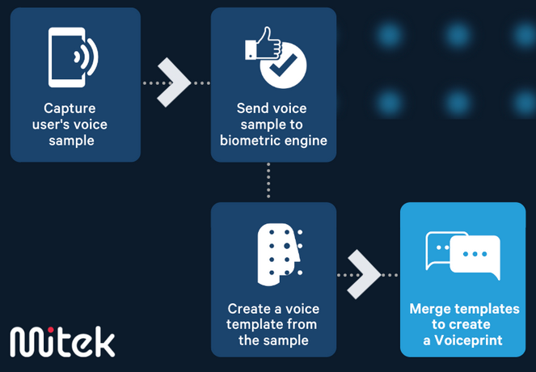
Applications of DSP
Voice Biometrics
Definition and Role of Voice Biometrics:
Voice biometrics uses unique vocal characteristics for identity verification and authentication.
Applications:
Speaker Identification and Verification: Verifying an individual's identity based on voice patterns.
Secure Access Control (Voice-based Authentication): Enhancing security by using voiceprints for user authentication.

Slide 21
Applications of DSP
Automatic Subtitling and Captioning
Importance of Automatic Subtitling:
Providing textual representation of spoken content for accessibility and comprehension.
Applications:
Broadcasting (TV, Films): Adding subtitles for viewers with hearing impairments or language barriers.
Online Video Content (YouTube, Streaming Platforms): Enhancing the accessibility of online videos with automated captions.

Slide 22

Applications of DSP
Language Translation
Speech-to-Speech Translation Technologies:
Advanced systems that translate spoken language from one language to another in real time.
Applications:
Multilingual Communication: Facilitating cross-language communication without human interpreters.
Real-Time Translation Services: Enabling travelers, business professionals, and international users to communicate effectively.

Slide 23
Applications of DSP
Speech Analytics
Speech Analytics:
Using speech processing techniques to analyze and derive insights from spoken data.
Applications:
Customer Call Center Analysis: Monitoring customer-agent interactions for quality assurance and customer experience improvement.
Market Research and Sentiment Analysis: Analyzing customer feedback and sentiment expressed in spoken language.
Quality Assurance and Compliance Monitoring: Ensuring adherence to regulations and standards in communications.

Slide 24
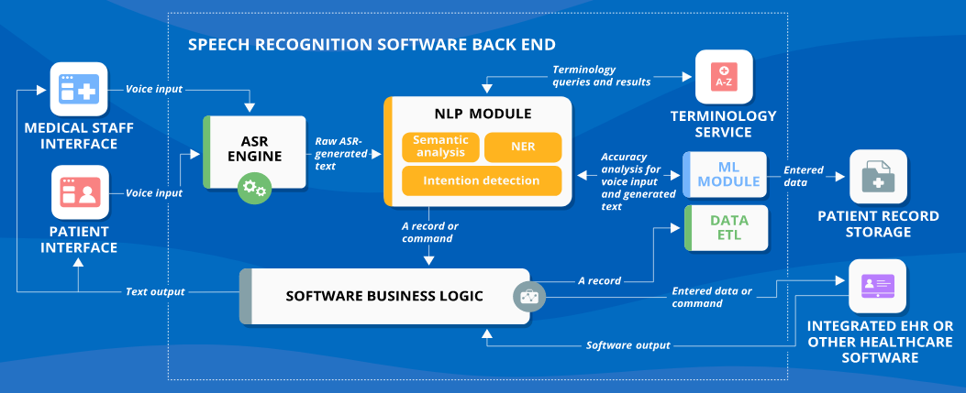
Applications of DSP
Healthcare Applications
Use of Digital Speech Processing in Healthcare:
Enabling innovative solutions for patient care and diagnostics.
Applications:
Telemedicine and Remote Patient Monitoring: Facilitating remote consultations and health monitoring using speech technology.
Speech Therapy and Rehabilitation: Supporting speech and language rehabilitation through interactive tools and feedback systems.

Slide 25
Applications of DSP
Educational Tools
Role of Speech Technology in Education:
Enhancing learning experiences and accessibility.
Applications:
Language Learning and Pronunciation Practice: Providing feedback on pronunciation and language skills.
Interactive Learning Platforms: Engaging students with voice-enabled interactive exercises and assessments.

Slide 26
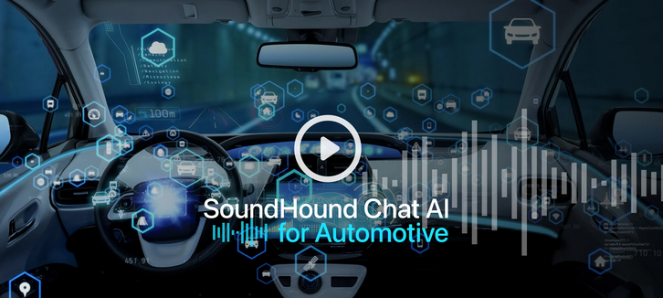
Applications of DSP
Automotive Speech Interfaces
Integration of Speech Technology in Vehicles:
Hands-free controls and voice-activated features for driver convenience and safety.
Applications:
Hands-Free Controls for Navigation, Entertainment, and Communication: Allowing drivers to operate car systems without manual input.

Slide 27
Summary
The Speech Signal: Overview of speech production, transmission, and time-frequency representations.
The Speech Stack: Layered architecture for speech processing, including signal processing, feature extraction, and pattern recognition.
Applications of DSP:
Speech Recognition: Converting spoken language into text.
Speech Synthesis: Generating speech from text.
Speech Enhancement: Improving clarity in noisy environments.
Speaker Identification: Used in security and personalization.

Slide 28
Q & A

